Slide 1
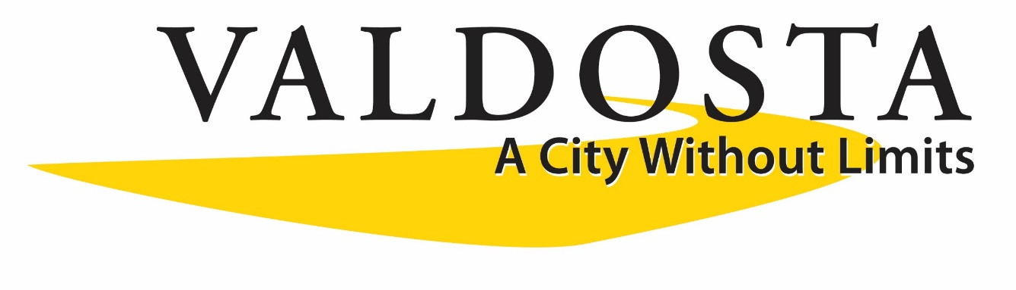
Targeting Federal Programs to Distressed and Underserved Areas

Slide 2
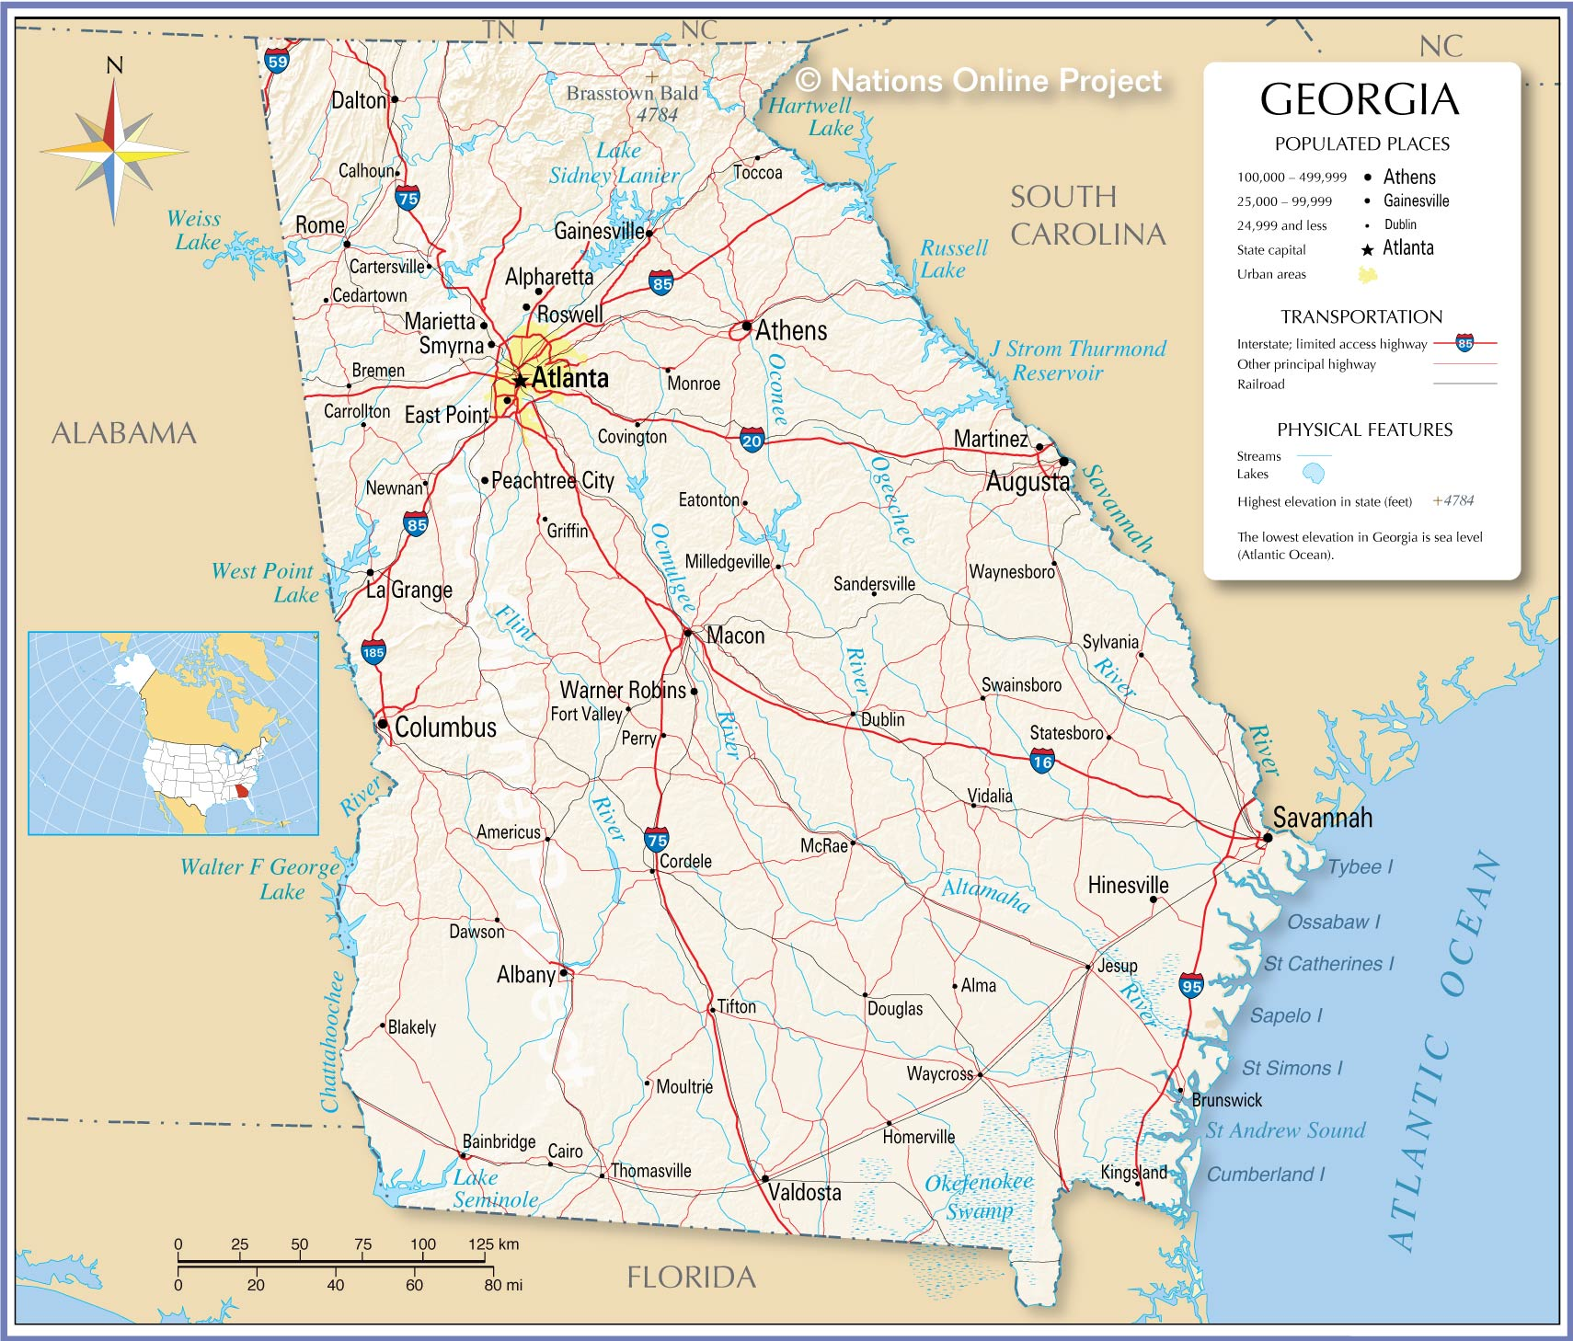

Slide 6
Public Notice and Hearing To The Citizens
Of the City of Valdosta
The governing body of the City of Valdosta has approved its Proposed Statement of Objectives of Projected Use of Funds for its FY 2021 Entitlement Grant which will become its FY 2021 Annual Action Plan. The Annual Action Plan provides information on proposed usage of the Community Development Block Grant (CDBG) funding. Citizens wishing to make a comment on the following Statement of Objectives or the activities shown below may do so in writing to the Neighborhood Development Division Office, City Hall Annex, 300 North Lee Street, Room 206, Valdosta, Georgia; Monday through Friday or via our website www.valdostacity.com until May 10, 2021 at 5:00 p.m. A virtual Public Hearing will be scheduled for Wednesday, May 5, 2021 at 4 pm via Facebook Live on our City website – www.valdostacity.com to present the proposed FY21 Annual Action Plan. The information contained in this notice or the proposed Annual Action Plan will be made available through Limited English Proficiency (LEP) language assistance services as requested in the Neighborhood Development Division Office.
Any questions or comments regarding this information may be directed to the Neighborhood Development Division at (229) 671-3617.
City of Valdosta
Community Development Block Grant
Annual Action Plan
For the FY 2021 HUD Entitlement Grant
The City of Valdosta is scheduled to receive $693,677 from the U.S. Department of Housing and Urban Development (HUD) as its Entitlement funding allocation under the Community Development Block Grant Program.
Unless otherwise designated concentrated use of funds will be in the Designated Revitalization Area consisting of Census Tracts 0105.00, 106.03-block2, 0108.00, 0109.00, 0110.00, 0113.01, and 113.02. All activities are expected to meet or exceed the 70% overall program benefit to low and moderate income citizens. Each activity must meet one of the three National Objectives of the CDBG program. These National Objectives are:
Provide a benefit to low and moderate – income persons; Prevent or eliminate slum and blight; OR
Meet an urgent community need that threatens the health or welfare of residents
Listed below are the various programs and activities that are planned to be carried out in the
FY 2021 and the National Objective that each addresses.
ECONOMIC DEVELOPMENT……………….………$50,000.00
Continuing Small Business Education and Technical Assistance
Funding will be used to inform, educate and promote economic development in conjunction with the Valdosta Small Emerging Business (VSEB) Program through continuing education opportunities and small business technical assistance. ($50,000)
National Objective is to benefit low and moderate income persons and an area benefit for low – moderate income populations
HOUSING………………………………………….....$478,442.00
Single Unit Residential Rehabilitation
Funds will be used to offer owner-occupied housing rehabilitation through direct loans and grants to low and moderate income homeowners for the rehabilitation of single-family residential structures. An emergency home repair program, minor repair program, major repair program, demolition and lead paint abatement will be conducted by City Staff. National Objective is to benefit low and moderate income persons ($468,442)
Fair Housing Community Education
Funds will be used to inform, educate and promote fair and equitable housing for low moderate income persons who reside within Designated Revitalization Area of the City of Valdosta.
National Objective is to benefit low and moderate income persons ($10,000)
PROGRAM ADMINISTRATION…………….…….….. $138,735
Funds will be used to pay portions or entire salaries, benefits, and administrative costs of Community Development and Finance Department staff in oversight, management, monitoring, and coordination of CDBG programs ($138,735)
PUBLIC SERVICE……………………………………….…$26,500
Great Promise Partnership Program Funding
Funding will be used to hire high school students who are eligible participants in the Great Promise Partnership Program. These positions will provide part-time employment hours during the school year and full-time employment hours during summer and school breaks. ($25,000)
National Objective is to benefit low to moderate income persons
Neighborhood Action Associations (NAAs)
Funding will be used to assist residents of the neighborhoods in the Designated Revitalization Area (DRA) of the City of Valdosta with organizing formal neighborhood associations. This funding will be limited to $500 per recognized group for centralized community information systems only (neighborhood boards or hubs). ($1,500)
TOTAL EXPENDITURES ………………..………... $693,677***
FOR ADDITIONAL INFORMATION, CONTACT THE CITY OF VALDOSTA NEIGHBORHOOD DEVELOPENT DIVISION AT (229) 671-3617
*** Please note allocation amounts may increase or decrease pending the approval of the Congressional budget. All potential additional funds will be programmed into one of the proposed activities for the funding year.

Slide 7
City of Valdosta Single Family Residential Rehabilitation Program (SFRR):
City of Valdosta is one of the last communities who offers a residential rehabilitation program which is issued in the form of a zero percent, zero payment loan program (grant) with a required affordability period to applicants.
Three levels of assistance and Affordability Periods –
Emergency Repairs – up to $10,000 – 10 years
Residential Rehabilitation – up to $45,000 – 15 years
Residential Reconstruction – up to $90,000 – 15 years
Housing inspections and assessments based on the International Property Maintenance Code checklist
Open Application Period yearly from January 1st – April 30th or until the yearly housing budget has been expended.

Slide 8
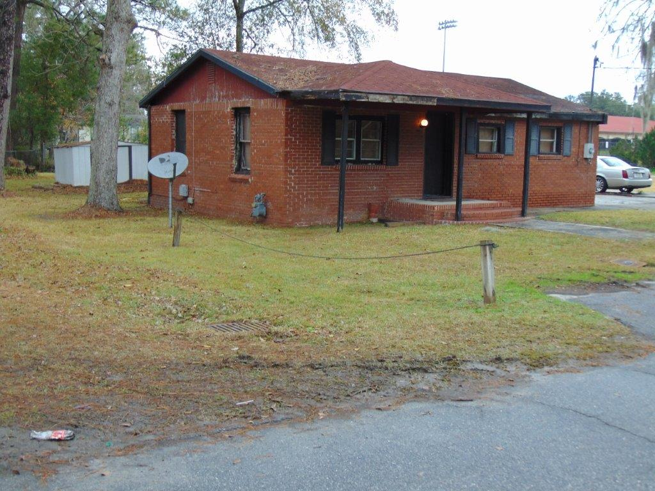

Slide 9
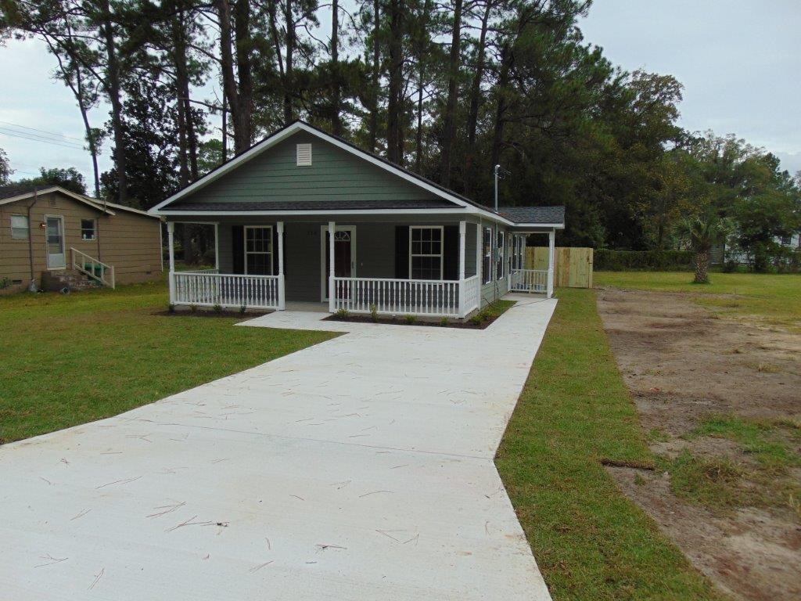

Slide 10
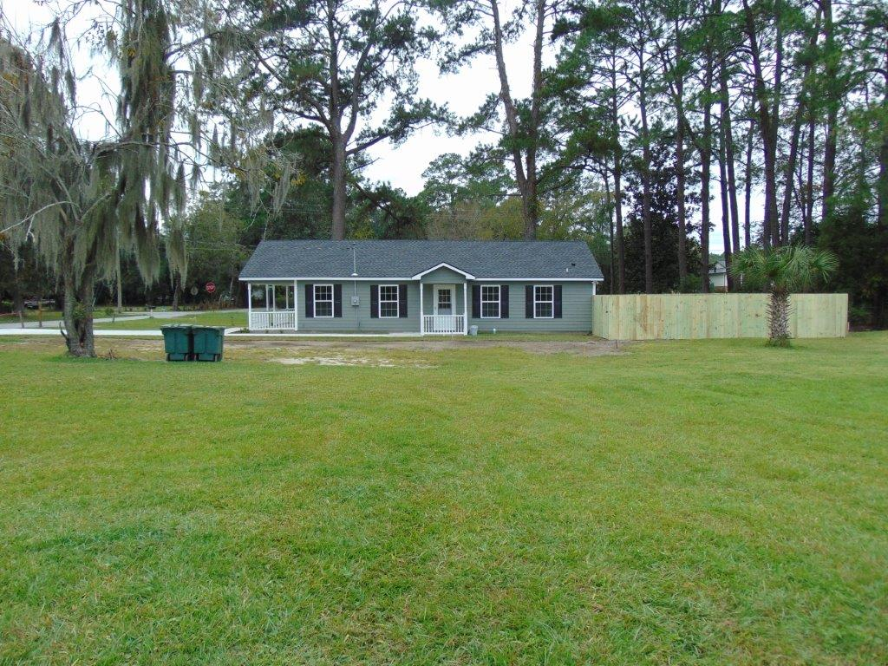

Slide 11
Vanassa Ross
Dir., Neighborhood Development & Community Protection vflucas@valdostacity.com
(229) 671-3617

